Slide 1
PREDICTING USED VEHICLES PRICES
PROG8430-Data Analytics Mathematics and Algorithm
GROUP MEMBERS
1. JEMIMA PAULRAJ (8890669), PGDM- Big Data Solution Architecture
2. DELAXSHANA SANTHIRAVATHANAN (8932185) , PGDM-Big Data Solution Architecture
3. GEEDHU KIZHAKEPURA VELAYUDHAN (8899510), PGDM -Big Data Solution Architecture

Slide 2


Problem Definition
Predicting Used vehicle sales price using various machine learning technique and comparing their performance.

Slide 3

ABSTRACT
The goal of this project is to build machine learning model that can precisely predict a used car's price based on its attributes so that buyers can make proper decisions. The data is preprocessed, and it will be used to build model for predicting the vehicle’s selling price.

Slide 4
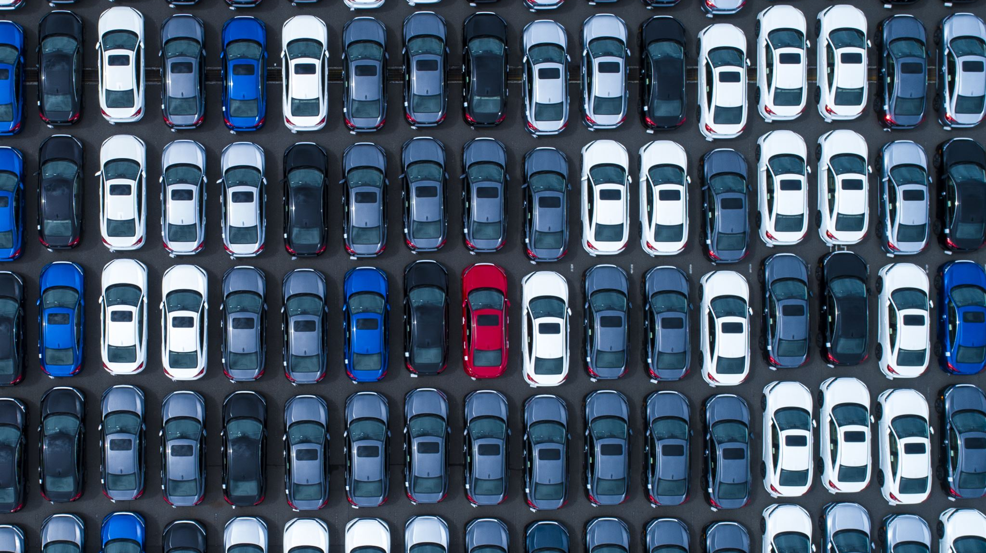
MOTIVATION
From in the user’s perspective, it may be challenging to decide whether a used vehicle worth the price being offered.
From in the seller’s opinion, it is also a problem to properly price a used car. Based on existing data
The purpose of this project is to use machine learning skills to predict exact price of used vehicle.

Slide 5

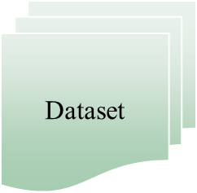
Project flow
Preprocess
Model
Prediction
(Sales_Price)

Slide 6

DATASET

Slide 7

Dataset
The dataset is taken from Kaggle[1].
URL of the dataset :
https://www.kaggle.com/datasets/nehalbirla/vehicle-dataset-from-cardekho?select=car+data.csv
Dataset Name : CAR DETAILS FROM CAR DEKHO

Slide 8
Attributes of the dataset
Name : Brand name of the vehicle.
Year : The year or edition of the vehicle.
Km-driven : The total kilometres driven by the previous owners.
fuel : The type of fuel used by the vehicles.
Seller type : Sold by dealer or an individual.
Transmission : The type of transmission system the vehicles use.
Owner : Whether the ownership is First hand, Second hand or other.
Selling-price : The current price of the vehicles being sold. (Target Variable)
Present-price : Original vehicle price

Slide 9
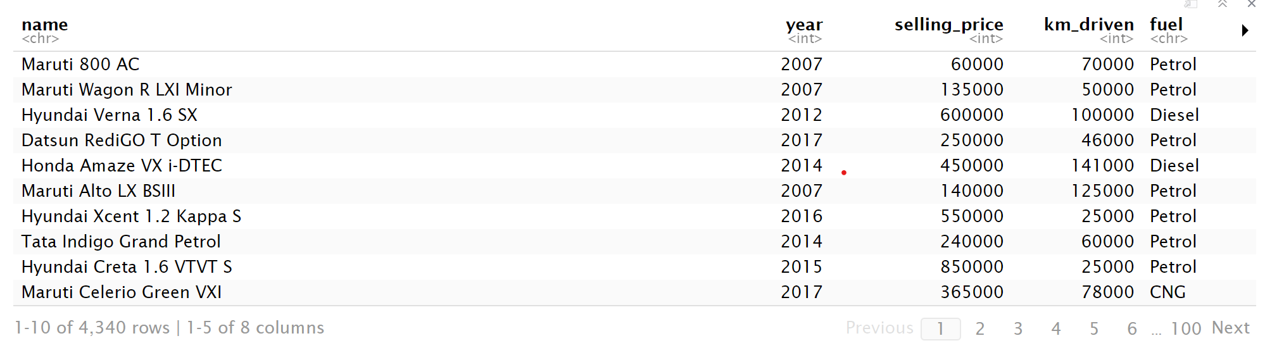
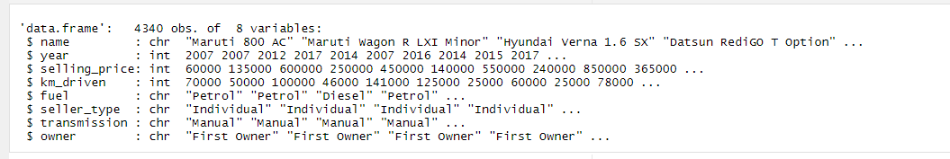
Sample data
Dataset has 4340 observations about the used cars, and it consists of 8 attributes.

Slide 10
Preprocess

Slide 11

Data cleaning
MODIFY THE COLUMN NAME
REMOVE MISSING VALUES
CONVERT CHARACTER TO FACTOR VARIABLE
REMOVE DUPLICATE VALUES
DETECT AND REMOVE OUTLIERS

Slide 12
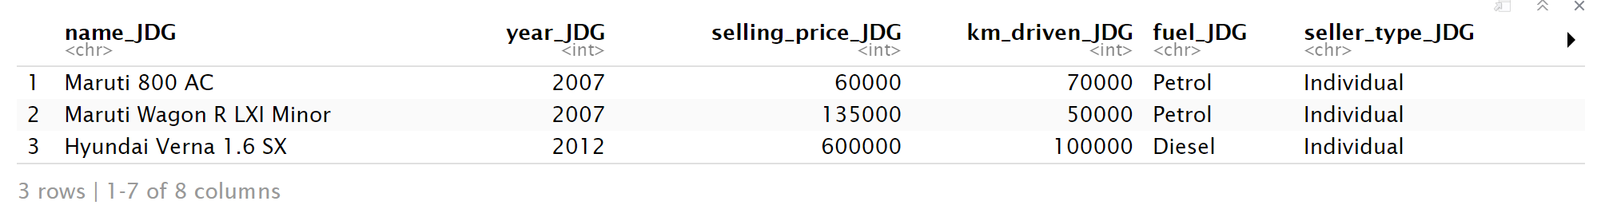
Data Cleaning
1. MODIFY THE COLUMN-NAME
Initials of the team members are added to the column name
2. REMOVE MISSING VALUES
Our Dataset doesn’t have any missing values

Slide 13
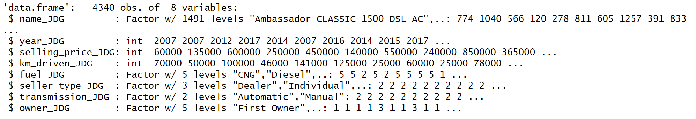
Data Cleaning Cont..
3. Converting all the character to a factor variable

Slide 14


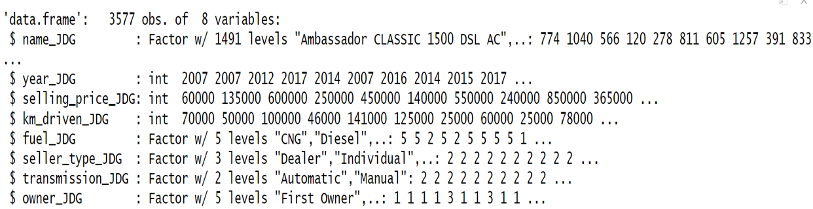
Data cleaning Cont..
4. Removing Duplicate Values
After Removing Duplicate Values
There are 763 duplicate values present

Slide 15
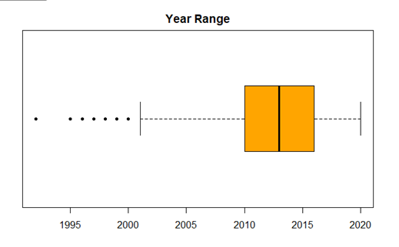
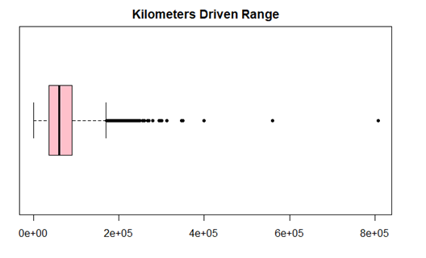
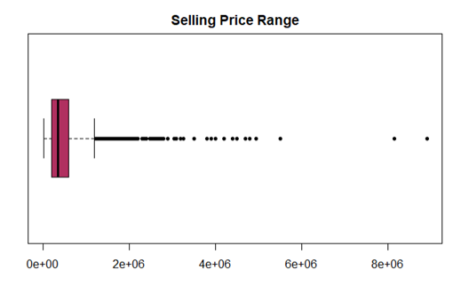
Data Cleaning Cont..
5. Detecting and Removing Outliers
We are using Boxplot and density plots to identify the outliers for numerical variables and Bar chart for factor variables.
Boxplot
We can able to see outliers in all these variables.

Slide 16

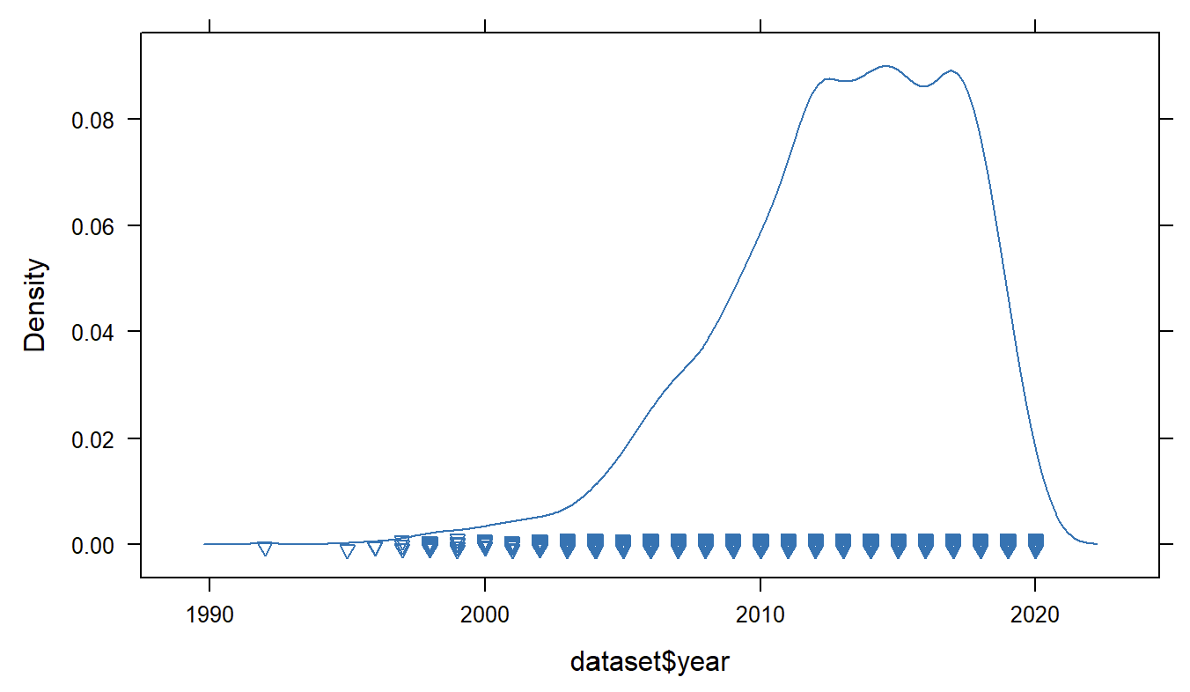
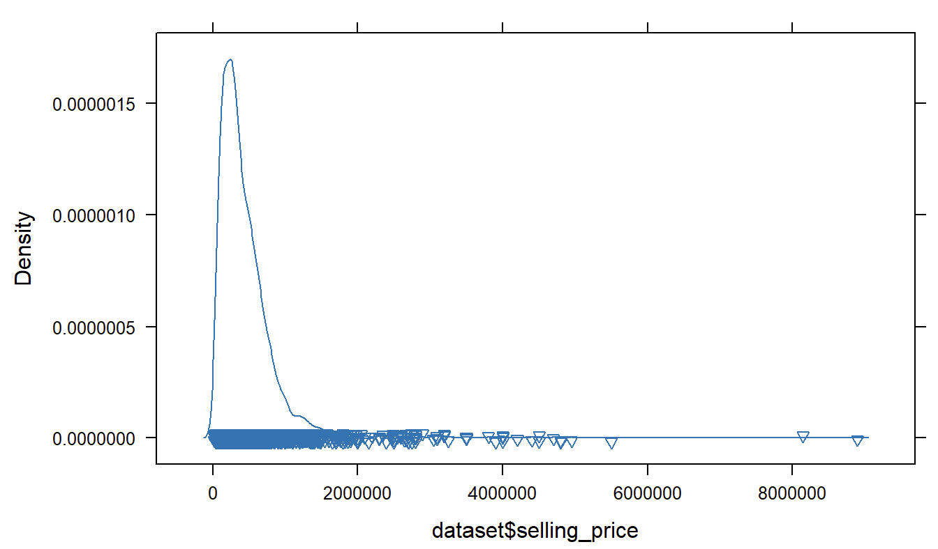
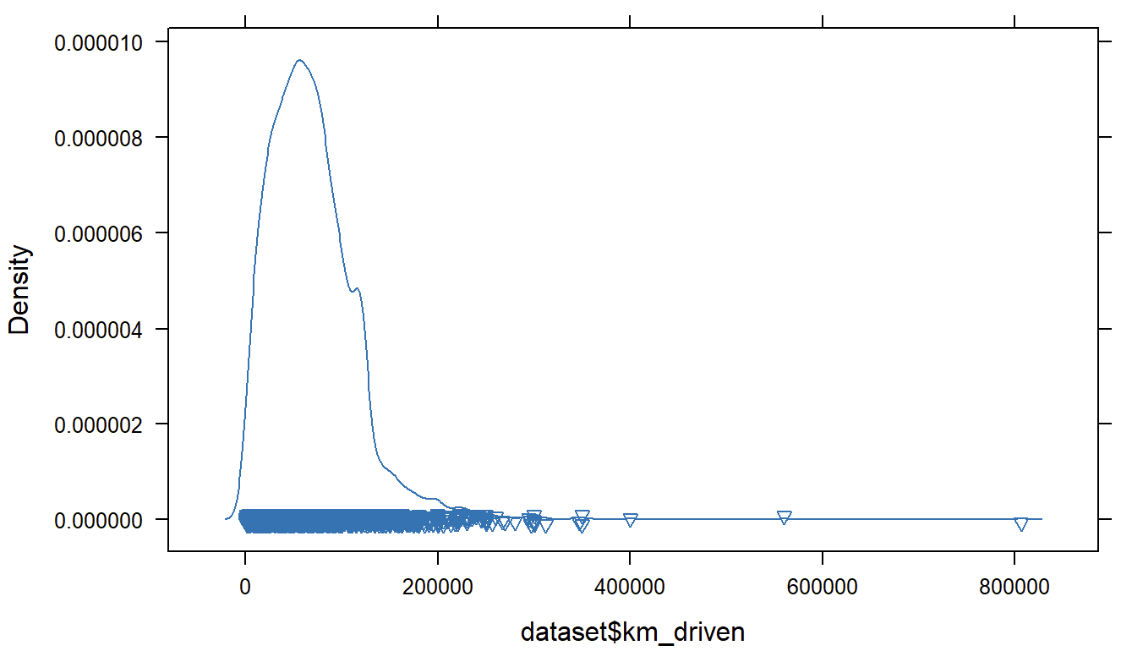
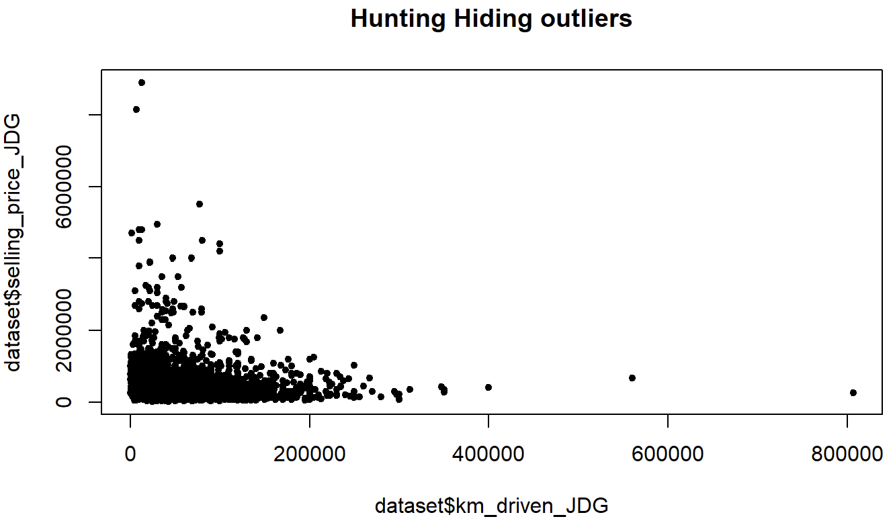
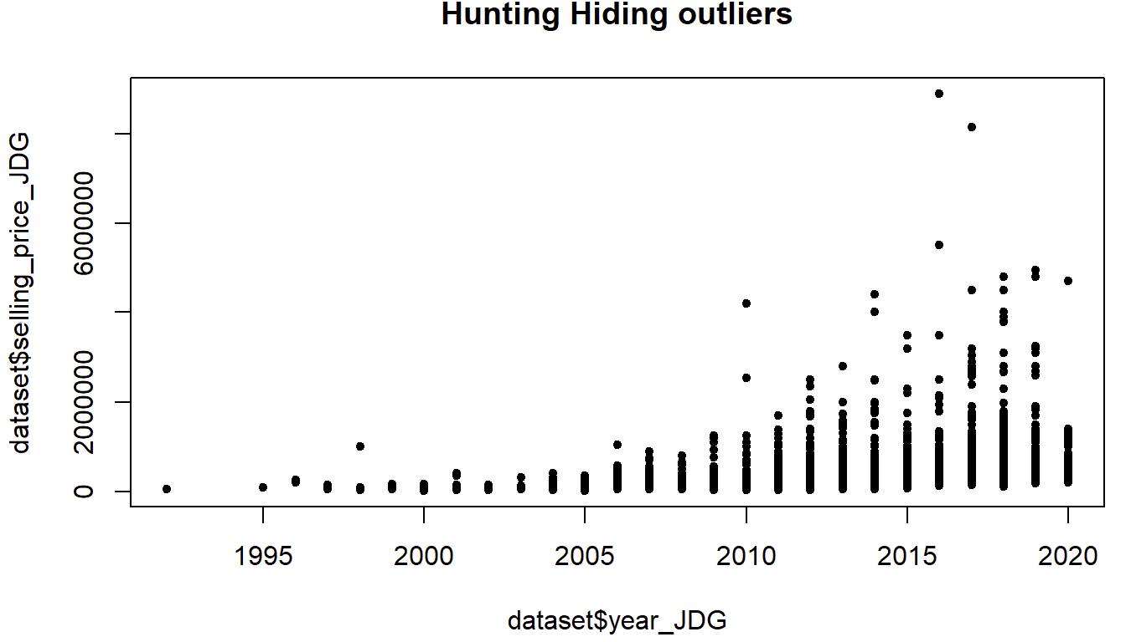
Density Plot
SCATTER PLOT

Slide 17
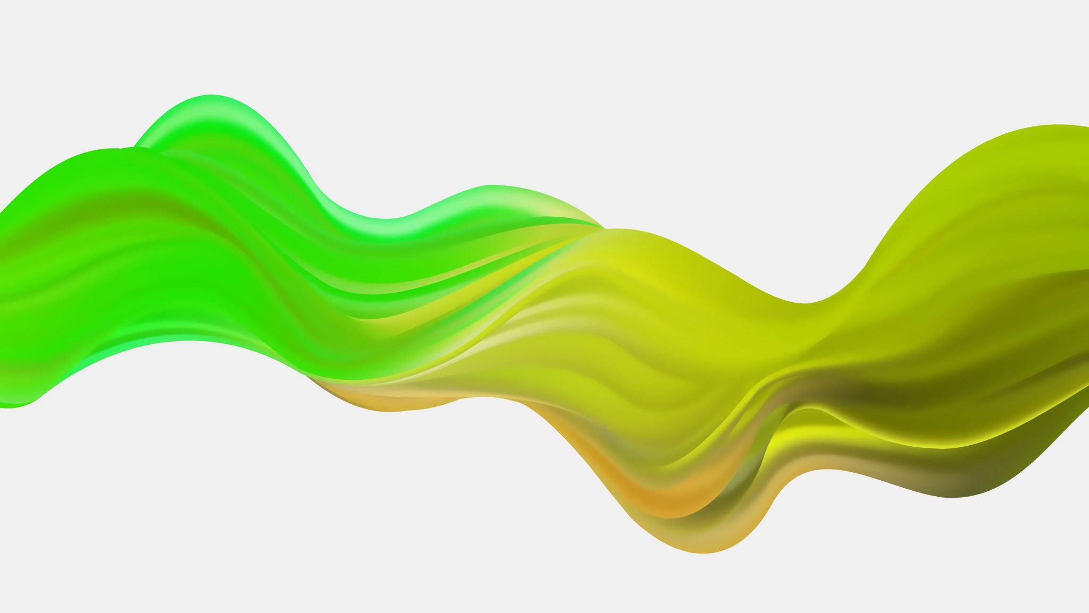
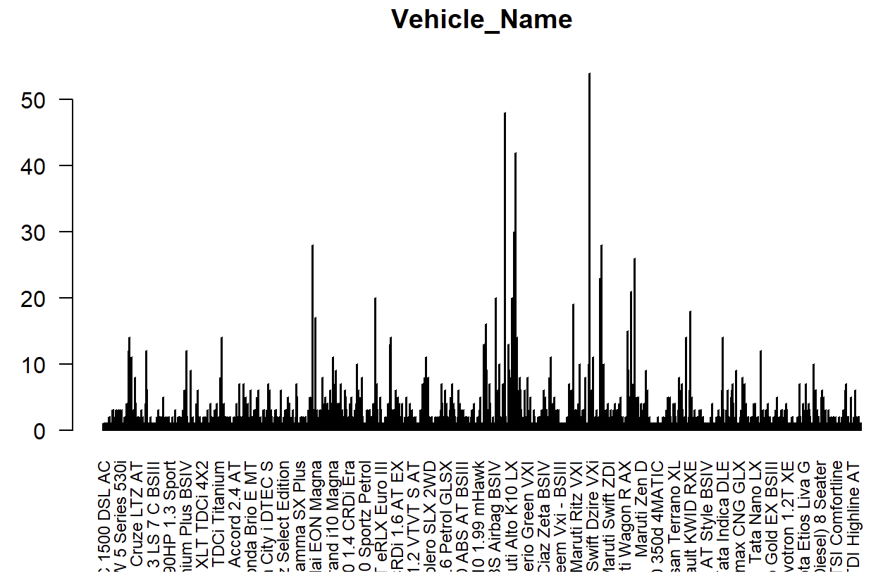
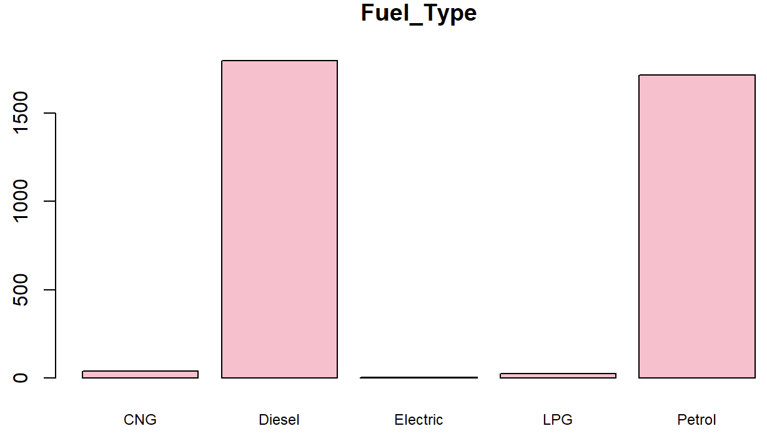
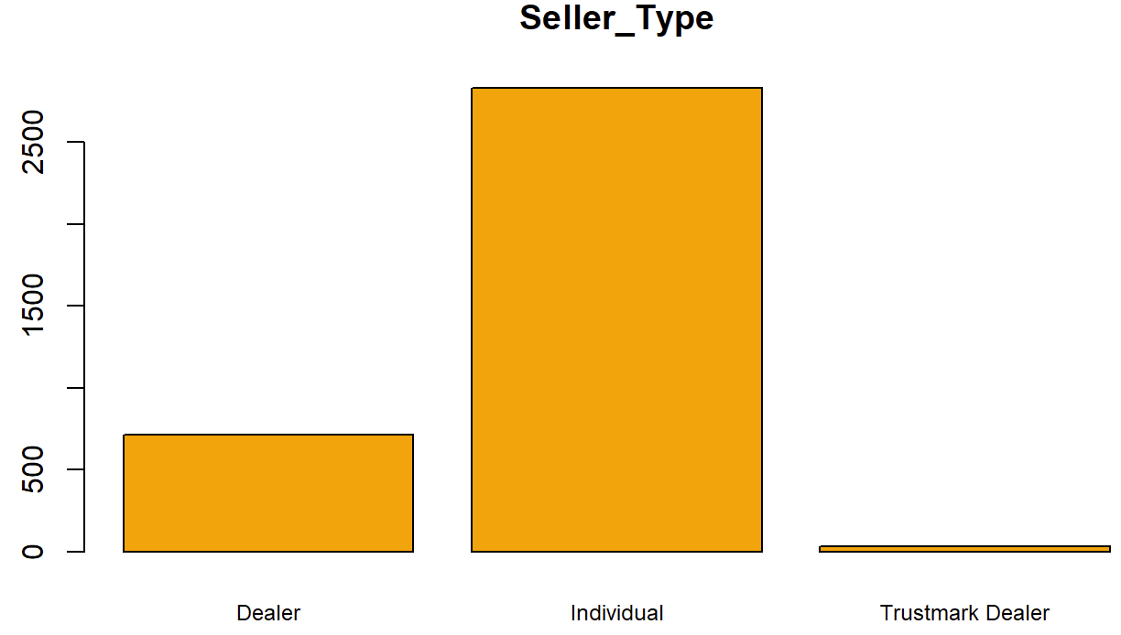
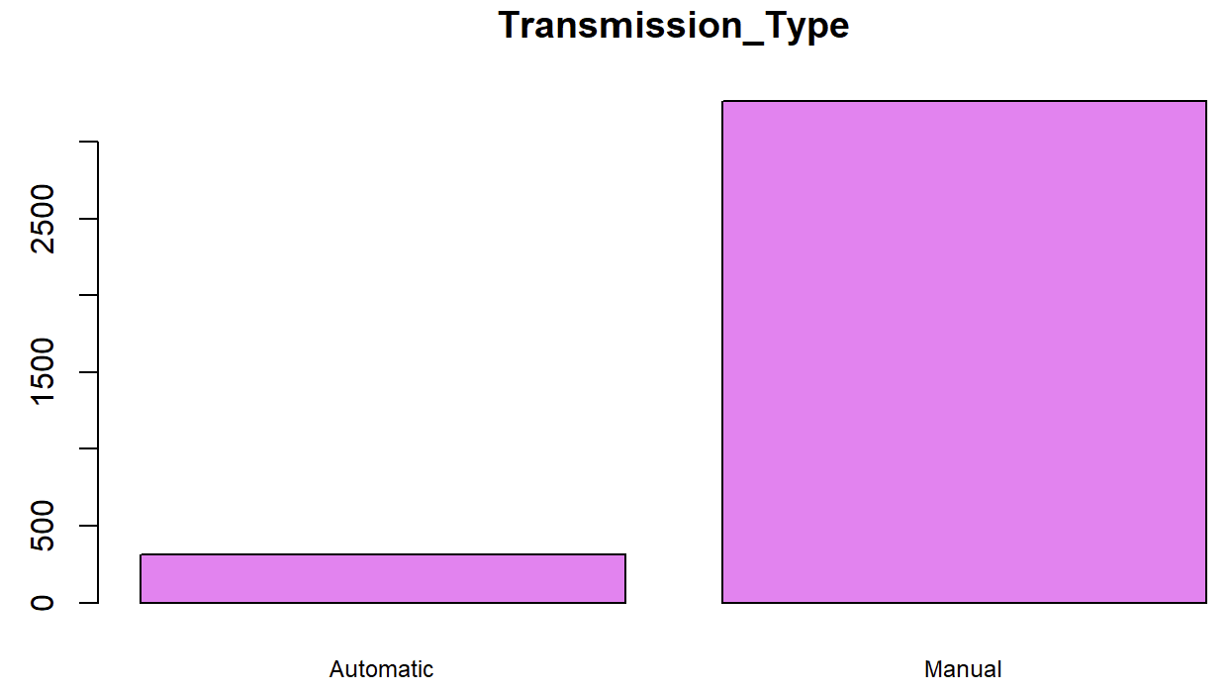
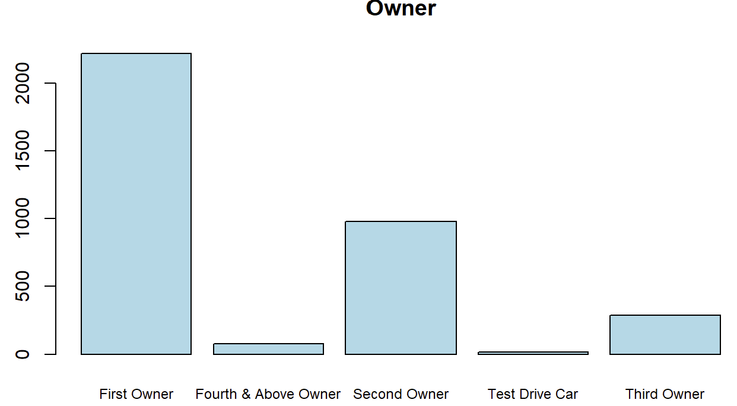
BAR CHART
We are removing Vehicle_name attribute since it doesn’t have much impact on vehicle’s sales price prediction.

Slide 18
Removing OUTLIERS
We will not remove outlier for km_driven and Selling price because of the following reasons:
1. The Kilometer Attribute is crucial. A used car may be in pristine condition or may have been driven for countless kilometers, depending on the prior usage and years of ownership.
2. The Selling Price Attribute is another key factor. The selling price of a used car can be volatile, based on various circumstances like kilometers driven, demand, and the number of years owned.
Outliers removed for year attribute:
In Year Attribute we have values before 2000, and we are not considering those values as they are outdated.
Year < 2000 , 25 values has been removed as the outliers

Slide 19

FEATUTRE ENGINEERING

Slide 20

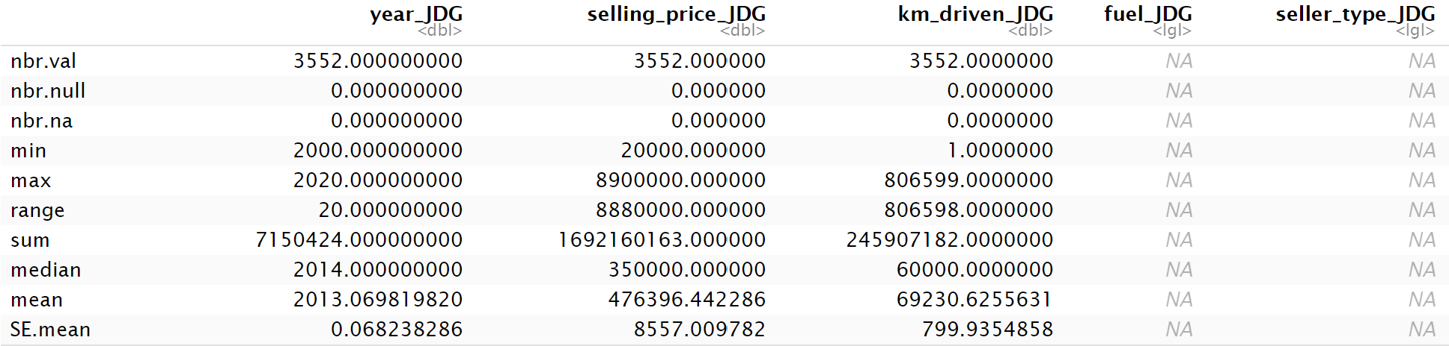
1.IDENTIFYING LOW VARIANCE
HGYCY
Year_JDG has the lowest coef.var
Although the coefficient of variation is low, since it belongs to year category. We have decided to include the year as a valid attribute in predicting the selling price. Therefore, we will not be removing it from our analysis.

Slide 21
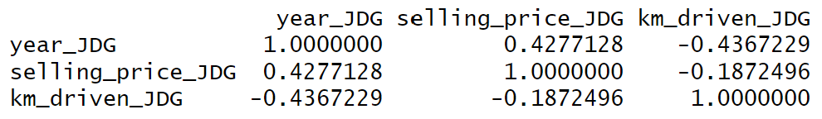
2. Identifying high correlation
According to the finding, there is no high correlation found among the features.

Slide 22
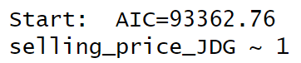
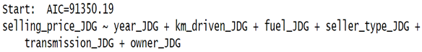
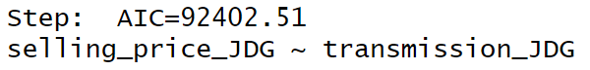
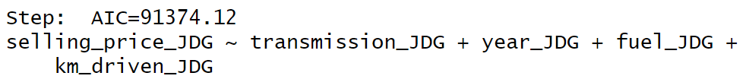
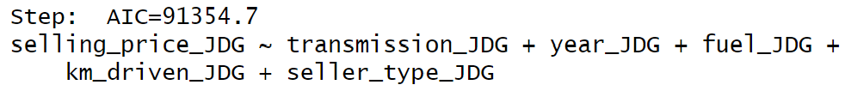
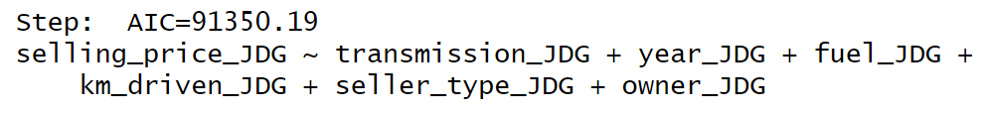
Wrapper Feature Selection
Forward Propagation
Backward Propagation
These features gives the lowest AIC Value, which indicates better fitting model

Slide 23
FUTURE PLANS
In Future we will be implementing the following Machine learning techniques to predict vehicle’s sales price.
Models
Linear Regression
Support Vector Regression
Random Forest Regression
We will be comparing the performance of these models and find the best model for predicting the vehicle’s sales price.

Slide 24

PHASE 2

Slide 25
WORKFLOW
Data Preprocessing is done.
Min-Max Scaling is done to reduce skewness.
The data is splited into train and test with 80:20 split.
The training data is trained with various models and comparison is made

Slide 26
MODELS
1.Multilinear Regression
2.Support vector regression
3.Random Forest Regression

Slide 27
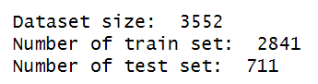
Train Test Split
Data is splitted into train and test with 80:20 split.

Slide 28
MULTILINEAR REGRESSION
Multiple linear regression is a statistical method used to understand how two or more independent variables are related to a single dependent variable by finding the best-fitting line.
It helps to predict outcomes based on these variables.

Slide 29
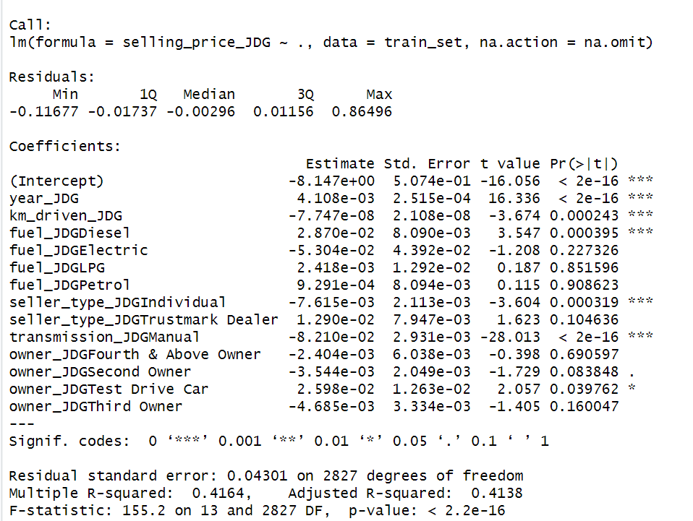
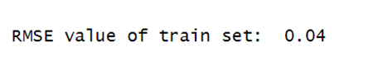
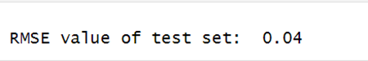
LINEAR REGRESSION
RMSE VALUE
Best Fit

Slide 30
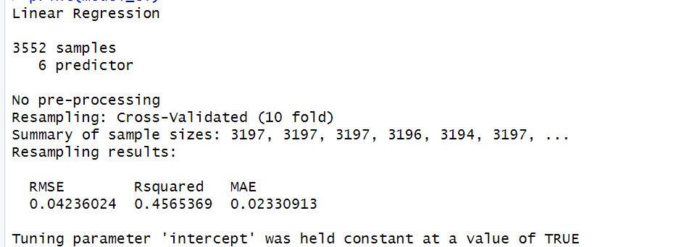
Split data using 10-fold cross validation

Slide 31
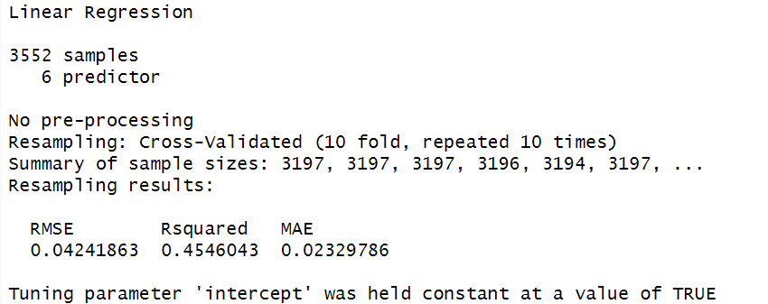
Split data using 10-times-K-fold Cross-Validation

Slide 32
10-fold cross validation VS 10-times-K-fold Cross-Validation
 | RMSE | RSQUARED | MAE
10-fold cross validation | 0.04236024 | 0.4565369 | 0.02330913
10-times-K-fold Cross-Validation | 0.04241863 | 0.4546043 | 0.02329786

Slide 33
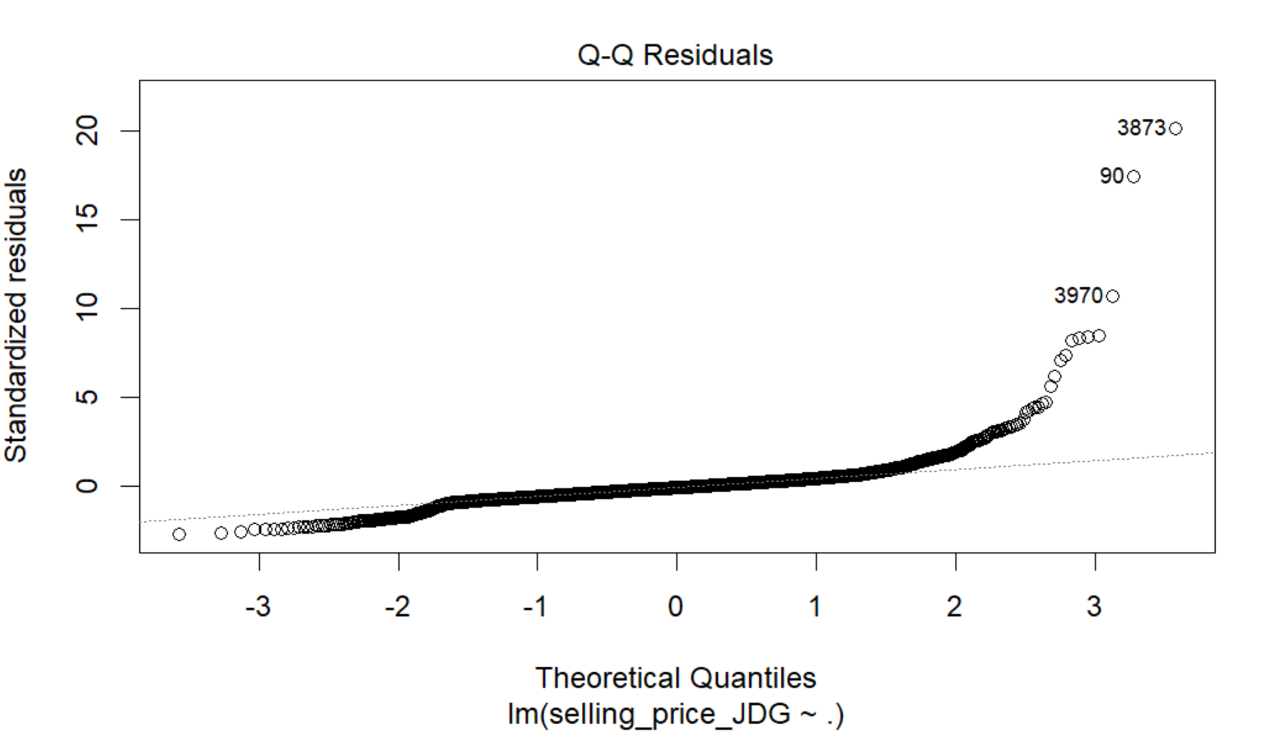
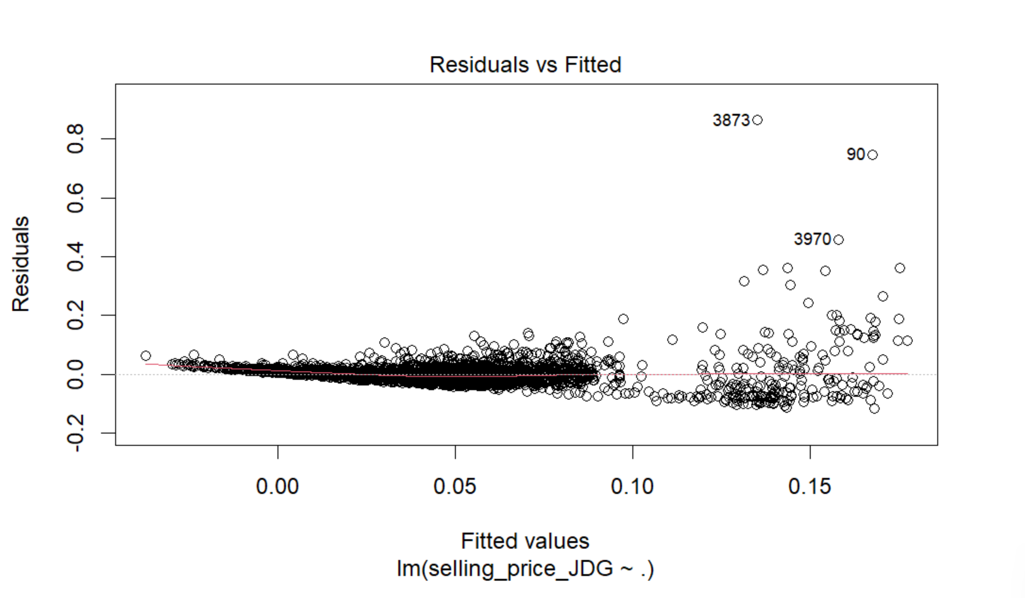
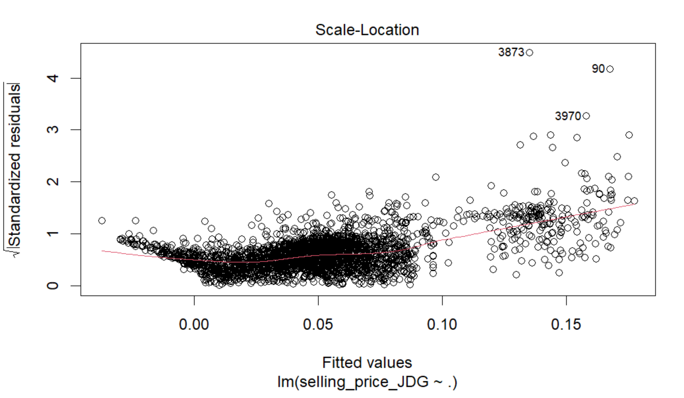
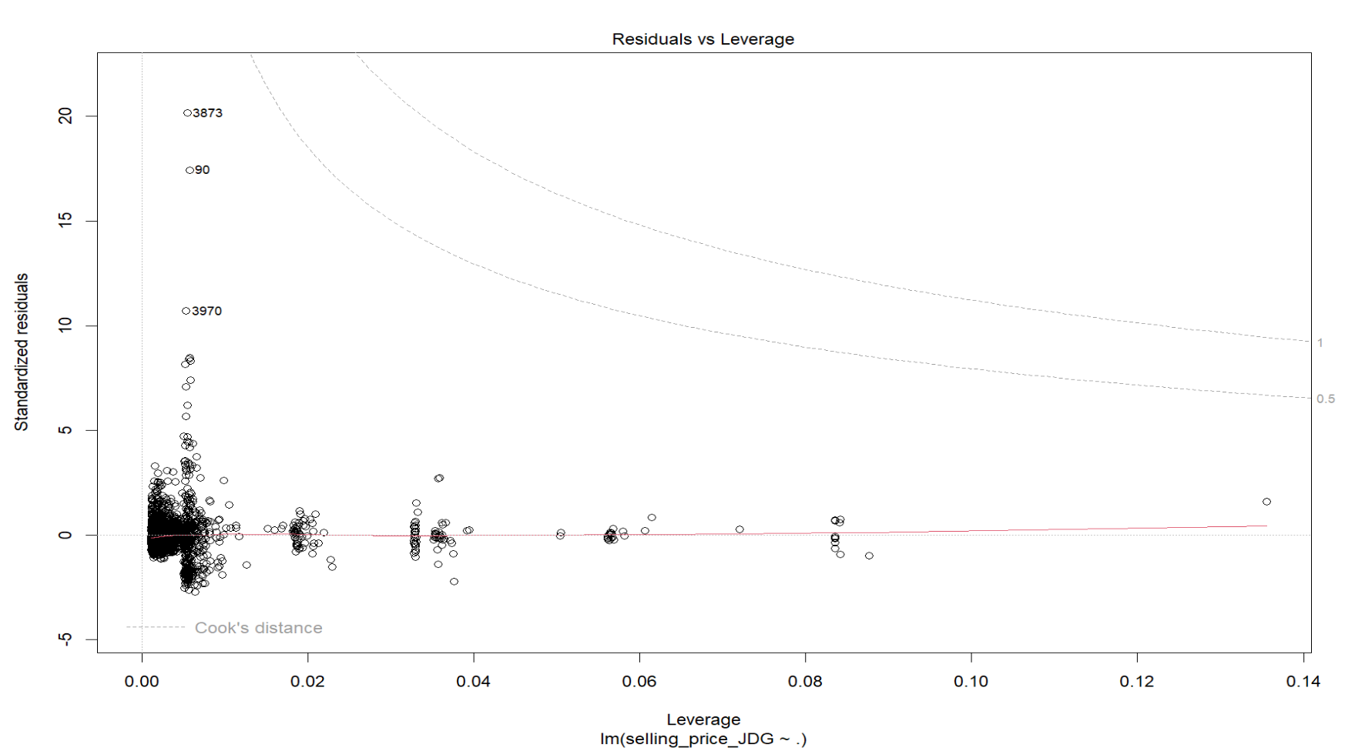
PLot MLR

Slide 34
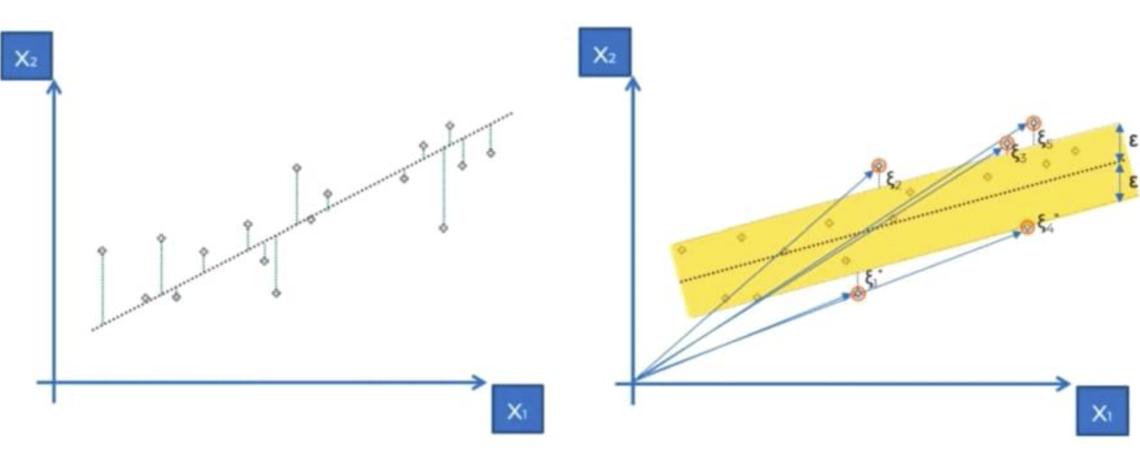
Support vector regression
It is a supervised machine learning technique used for regression.

Slide 35

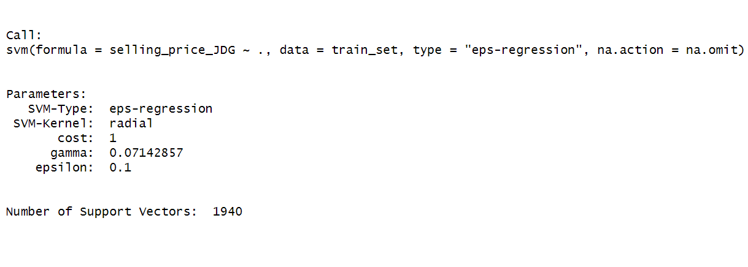
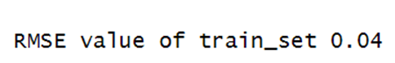
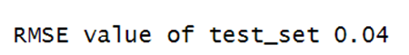
Support Vector Regression

Slide 36
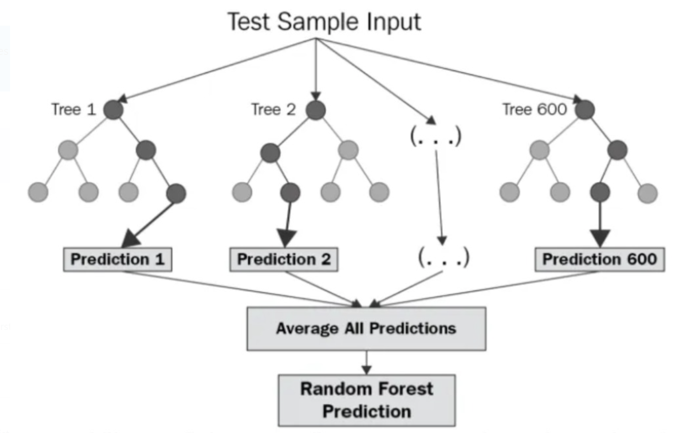
RANDOM FOREST REGRESSION
Random Forest Regression is a supervised learning algorithm that uses ensemble learning method for regression
combines predictions from multiple machine learning algorithms to make a more accurate prediction

Slide 37
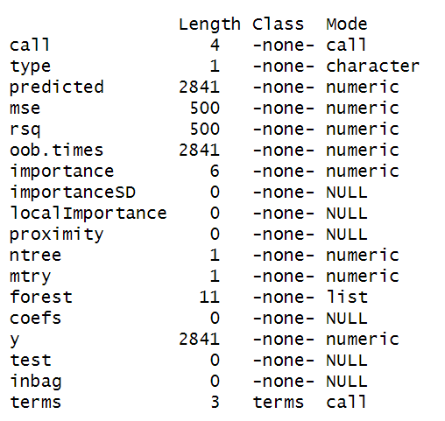
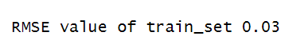
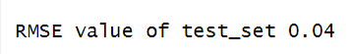
Random Forest Regression Model
RMSE

Slide 38
Time taken
Multilinear Regression
Support Vector Regression
Random forest Regression

Slide 39
COMPARING MODELS
Model Name | RMSE Value of Train set | RMSE Value of Test Set | Model training Time (Seconds)
Multi-Linear Regression Model | 0.04 | 0.04 | 0.02
Support Vector Regression | 0.04 | 0.04 | 1.19
Random Forest Regression | 0.03 | 0.04 | 3.744

Slide 40
conclusion
After comparing the RMSE values of all three models for both their training and testing data, we have determined that the multi-linear regression model is the superior choice due to its comparatively faster training time.

Slide 41
Contributions
Model Name | Done by
Multi-Linear Regression Model | Delaxshana
Support Vector Regression | Geedhu
Random Forest Regression | Jemima

Slide 42
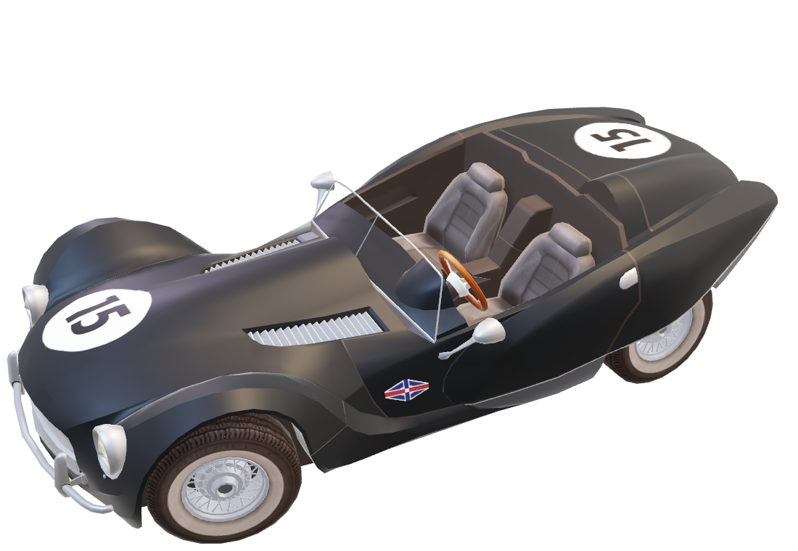
THANK YOU

